Slide 1
coral dev board imPlementation FOR ANOMALY DETECTION [IN DNP3 SCADA SYSTEMS IN SMART GRIDS]
GROUP - 03
HARISH MANUKONDA – cb.sc.u4aie24115
JYOTHSNA . V – cb.sc.u4aie24117

Slide 2
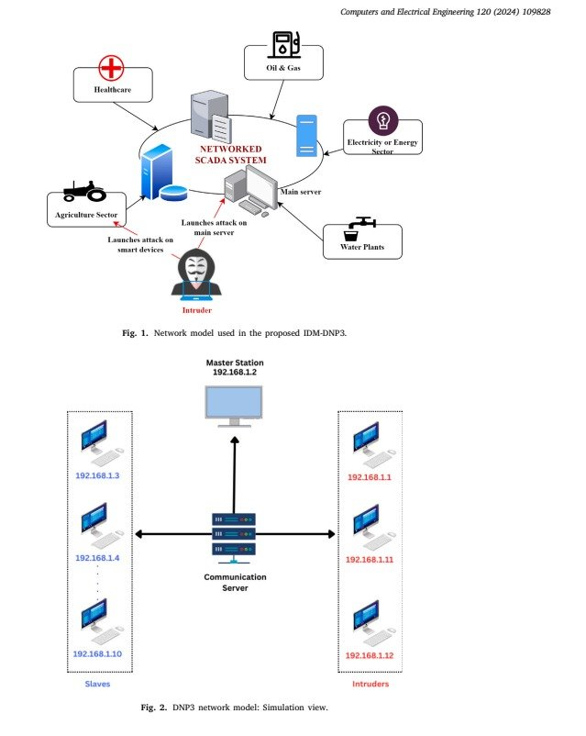
INTRODUCTION TO DNP3 IN SCADA
The DNP3, a widely adopted communication protocol in SCADA systems, facilitates real-time monitoring and control across critical infrastructure, like power grids, water systems, and energy management systems.
However, its inherent vulnerabilities to cyber threats, including unauthorized access and data manipulation, necessitates advanced security mechanisms.
This research aims to introduce an integrated approach combining Anomaly Detection for attack identification, with the Coral Dev Board to reduce latency, using DNP3 data flow in SCADA systems of smart grids.

Slide 3
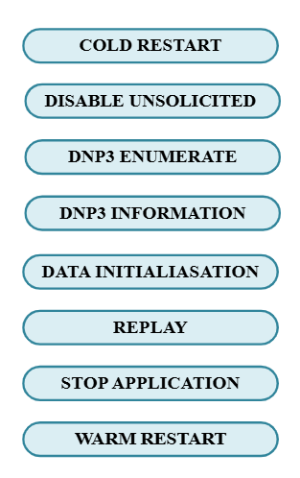
dataset overview
The DNP3 Parser dataset encompasses over 6,000 data flows, divided into 4,194 for training and 1,800 for testing, and features 102 attributes capturing traffic metadata, timing information, packet characteristics, and protocol behaviors.
The dataset consists of eight distinct attack types alongside a class representing normal, legitimate traffic. By simulating real-world challenges in intrusion detection, this balanced dataset highlights the pressing need to strengthen DNP3 against increasingly sophisticated and evolving cyber threats.

Slide 4
LITERATURE REVIEW
PAPER 1: AE-LSTM Based Anomaly Detection System for Communication Over DNP 3.0
ADVANTAGES:
High Accuracy & Efficiency – The AE-LSTM-based AI system detects DNP3 cyber threats with 99% accuracy, 98% TPR, and 1.6% FPR.
Enhanced EMS Security – The model strengthens power system resilience by detecting cyber threats in EMS and DNP3 vulnerabilities.
DISADVANTAGES:
Limited Generalization – Effective against known attacks but may struggle with zero-day threats and adversarial modifications.
High Complexity – Autoencoder-LSTM increases computational overhead, challenging real-time detection in large SCADA systems.
PAPER 2: An effective intrusion detection scheme for Distributed Network Protocol 3 (DNP3) applied in SCADA-enabled IoT applications
ADVANTAGES:
Multi-Class Classification – Classifies eight DNP3 attack types, improving threat differentiation and precision.
Optimized Features & Accuracy – Uses 99 features with XGBoost, Random Forest, and Decision Trees, achieving 99.56% accuracy in SCADA threat classification.
DISADVANTAGES:
Labeled Data Dependence – Limited effectiveness against novel cyber threats without prior training data.
Real-Time Constraints – Preprocessing and feature selection may introduce latency in SCADA monitoring.

Slide 5

PROPOSED INTRUSION DETECTION SYSTEM - 1
Anomaly detection refers to the identification of unusual patterns, anomalous events, or data points that deviate from expected behavior. In the proposed framework, all attack types are classified as a single, anomalous class, while the other, non-attack data is labeled as normal class.
To simulate a real-world environment, the dataset used in this study is subjected to manual data augmentation, generating 1,398 normal traffic data points. Furthermore, varying levels of intrusion, approximately 1%, 3%, 5%, and 7% of anomalous data are introduced relative to the normal traffic, effectively mimicking realistic data flow patterns.

Slide 6
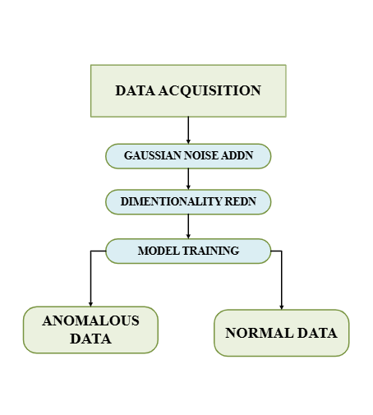
PROPOSED INTRUSION DETECTION SYSTEM -2
1) Gaussian Noise Injection: Gaussian noise is introduced into the dataset to simulate real-world perturbations and ensure that sensitive features are not overfitted by the model.
2) Dimensionality Reduction using Principal Component Analysis (PCA) is used for dimensionality reduction to project data into a lower-dimensional space and filter out less informative features while preserving the variance in the data.
3) Random Forest Classifier: Of all the Machine learning classifiers (like SVM, Decision trees, ANN, XGBoost, and Random forest) tried out for Anomaly detection for this dataset, Random Forest outperforms all others.

Slide 7
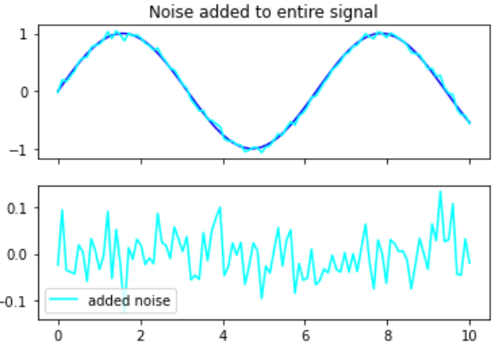
Gaussian Noise Injection
Noise injection in neural network training enhances generalization by adding randomness to inputs or internal components, reducing overfitting and improving resilience to real-world variations.
To add Gaussian noise to the dataset, random values from a Gaussian distribution are sampled and added to the original data. The noisy data is obtained as shown in the Equation:
y = x + ϵ
Probability density function for epsilon is:
f(ε) = (1 / (σ * √(2π))) * e^(-(ε - μ)² / (2σ²))

Slide 8
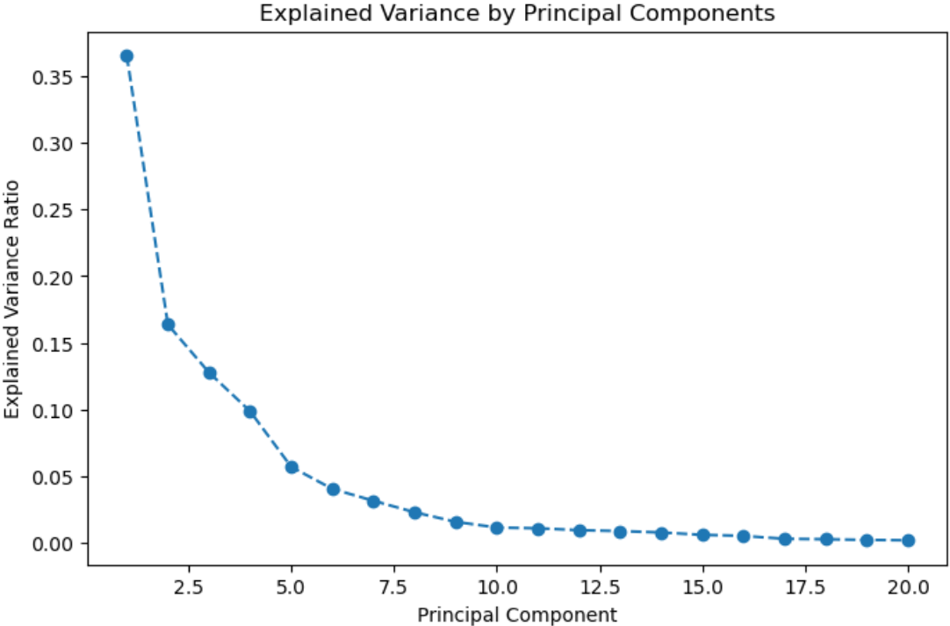
dimensionality reduction using PCA
Feature Scaling (Normalization):Ensures uniform feature scales using StandardScaler(), preventing dominance of large-value features and improving model efficiency.
Dimensionality Reduction (PCA): Reduces dimensions from 102 to 20 while preserving 90%+ variance, eliminating redundancy.
Outcome: Enhances training and inference speed while minimizing overfitting risk.

Slide 9
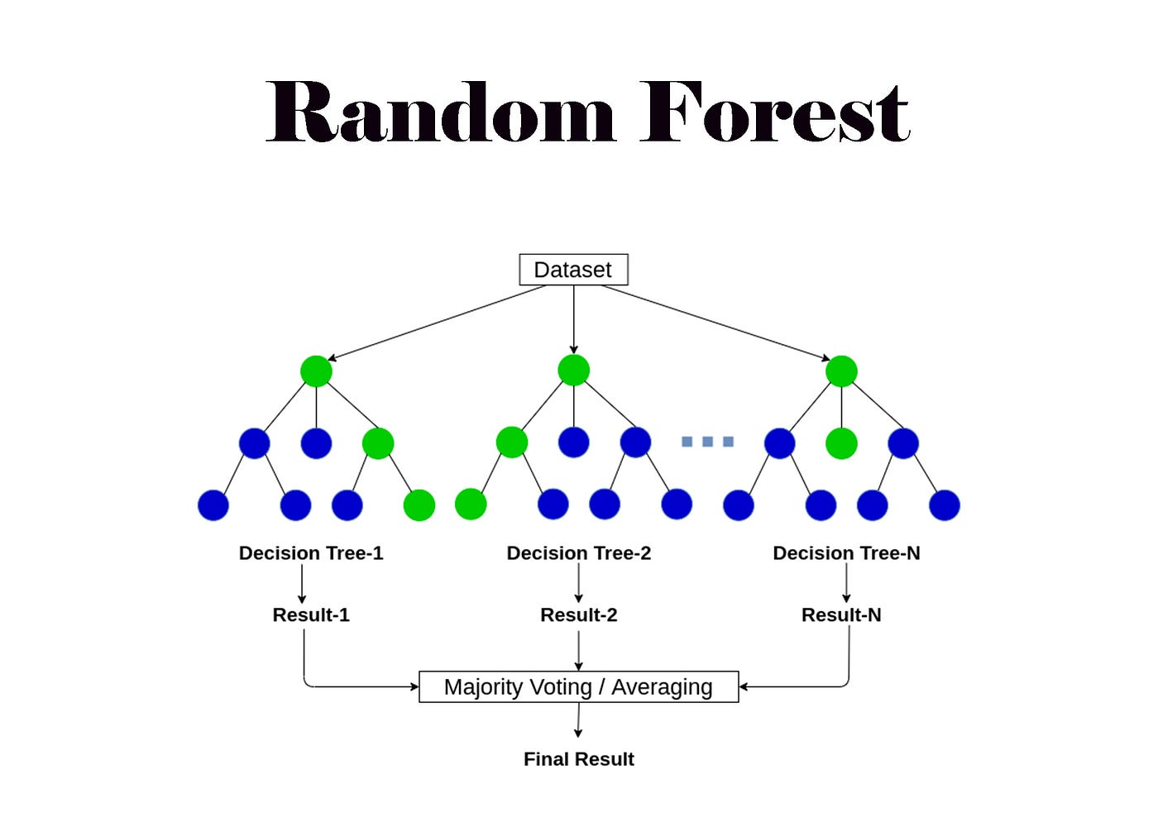
Random forest architecture
Random Forest (RF) is an ensemble learning algorithm that constructs multiple decision trees and combines their predictions to improve accuracy and reduce overfitting, which is widely used for classification and anomaly detection due to its robustness and efficiency.
This diversity is achieved through a technique called bagging (bootstrap aggregating). Bagging involves creating multiple random samples of the training data with replacement and training a separate decision tree on each sample.

Slide 10
SOFTWARE RESULTS
The Random Forest Classifier (RFC) was implemented for anomaly detection in DNP3-based SCADA systems. The model was evaluated at different intrusion rates (1%, 3%, 5%, 7%), showing high accuracy and perfect recall across all cases.
Intrusion Rate | Accuracy | Precision | Recall | F1 - Score
1% | 98.59% | 20.00% | 100% | 33.33%
3% | 99.65% | 90.91% | 100% | 95.24%
5% | 98.98% | 86.36% | 100% | 92.68%
7% | 98.66% | 82.61% | 100% | 90.48%
The Random Forest Classifier achieved a peak accuracy of 99.65% (3% intrusion rate) and maintained a perfect 100% recall across all cases, ensuring no anomalies were missed.

Slide 11

Challenges of Software-based RFCs
1. Bottlenecks in CPU/GPU-based Implementations
Traditional implementations using Python’s Scikit-Learn rely on CPUs/GPUs, as dataset size and tree complexity increase, such execution suffers from memory bottlenecks and inefficient branching operations.
2. Latency Issues with Deep Decision Trees
Inference latency rises with deeper trees as each input navigates multiple branches. More memory accesses and evaluations slow decision-making on traditional hardware.
3. Efficient Edge Inference with Coral Dev Boards
Coral Dev Boards leverage TPUs for low-power, high-speed inference, reducing memory bottlenecks and latency compared to CPU/GPU-based implementations.

Slide 12
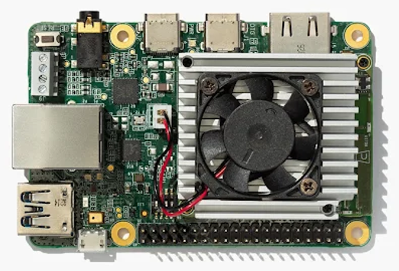
What is a coral dev board?
The Coral Dev Board is an edge-focused hardware platform by Google designed to accelerate machine learning (ML) inference. It integrates the Edge TPU, a specialized ASIC (Application-Specific Integrated Circuit) optimized for executing TensorFlow Lite models at high speed and low power.
🔹 Key Components: 1. Quad-core Cortex-A53 CPU 2. 1GB LPDDR4 RAM 3. Google Edge TPU (for AI acceleration) 4. WiFi, Bluetooth, USB, and GPIO for connectivity

Slide 13
Performance Trade-offs & Considerations
🔹 Why Transition to Coral Dev Board?
Edge TPU Acceleration – Runs ML models at up to 4 TOPS with low power consumption. ✅ Real-Time Processing – Reduces latency by running inference locally instead of the cloud. ✅ Privacy & Security – On-device computation minimizes data transmission risks. ✅ Developer-Friendly – Supports TensorFlow Lite, GPIO, USB, and other standard interfaces. ✅ Versatile Applications – Ideal for computer vision, speech recognition, and real-time AI tasks.
PROS | CONS
High-Speed AI Processing – Edge TPU enables rapid ML inference. | Limited RAM (1GB LPDDR4) – May restrict large ML models.
Low Power Consumption – Suitable for embedded and IoT applications. | Compatibility Issues – Requires TensorFlow Lite models optimized for Edge TPU.
No Cloud Dependency – Works offline, ensuring low latency. | Higher Initial Cost – More expensive than traditional microcontrollers.
Multiple Connectivity Options – WiFi, Bluetooth, USB, and GPIO support. | Restricted Hardware Expandability – Not as modular as general-purpose SBCs like Raspberry Pi.

Slide 14
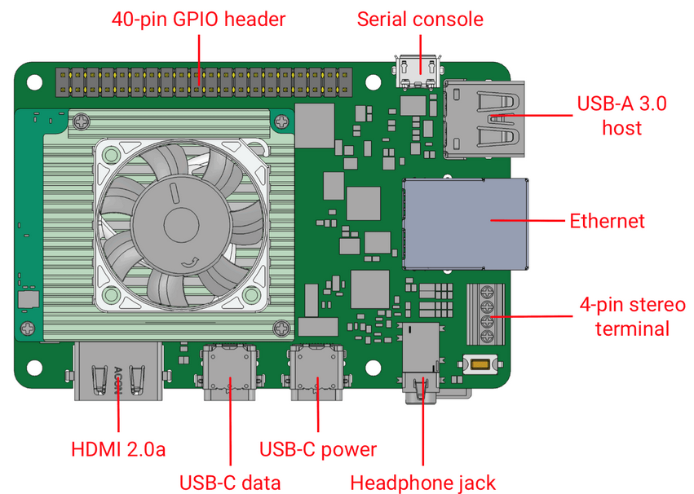
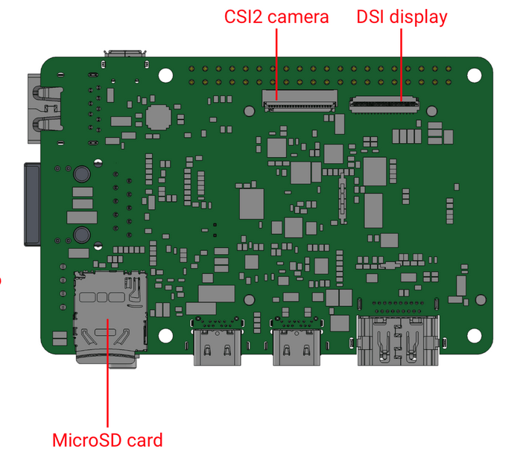
WHY coral TPU ?
Edge TPU Acceleration: The on-board Edge TPU can perform up to 4 trillion operations per second (TOPS) while maintaining low power consumption.
ML Inference on the Edge: By running ML workloads locally, the Coral Dev Board reduces latency, lowers reliance on cloud resources, and ensures better data privacy.
Developer-Friendly Design: It includes standard interfaces (GPIO, USB, Ethernet, etc.) and is compatible with the TensorFlow Lite framework, making it straightforward for prototyping and deploying embedded ML applications.
Versatile Use Cases: Suitable for computer vision, speech recognition, and various sensor-based applications—especially where real-time or near real-time inference is essential.

Slide 15

Thank you

